Slide 1
PROJECT REPORT BY BENJAMIN SOWAH JR
EMPLOYEE ATTRITION PROBLEM

Slide 2
EXPLAINING THE CODE
Importing libraries; before the dataset could be worked on certain libraries needs to be imported into the coding environment. These libraries are pandas, numpy , seaborn, and matplotlib.pyplot. The imported libraries will make functions we use in the code work.
Importing Datasets; this step is where the datasets provided for this project will be loaded to the coding environment so I can start working on it.
Cleaning the datasets ; the .shape(),.head(),.columns(),.isnull() function are responsible for cleaning the data checking for missing data, checking columns to see everything is on track. Then I can move to the next step.

Slide 3
CODE EXPLANATION CONTINUED………
Merging the datasets; the ex-employee data and current employee data needs to concatenated or merged into one dataset so that it can be applied to the machine learning model. Another header or column is added to differentiate the ex-employees from the current employees.
Encoding Categorical Data; Not all the data in the dataset are numbers or integers some are strings (words) so the need for encoding that is transforming the strings to integers. LabelEncoder a class of one of the imported libraries is used for the encoding , the dept,salary and job status the new added column were encoded.

Slide 4
CODE EXPLANATION CONTINUED………
Splitting dataset to train and test set; Here, the dataset is split into train and test set since that’s the rule for applying the dataset to the machine learning model. This is done by splitting the data into two percentages that is train set 80% and test set being 20%.
Feature Scaling; Feature Scaling is needed here for some of the machine learning models. Feature Scaling is also known as data normalization and it is a method used to normalize the range of independent variables in data processing.

Slide 5
BUILDING MACHINE LEARNING MODELS
I decided to use 5 different models so I can pick the best one. Decision Tree, Logistic Regression, Support Vector Machine, Random Forest and K Nearest Neighbors.
I successfully built the 5 machine learning models and predicted the results.
After I built a classification report which is a class of the libraries I imported so I can check the accuracy and other details about the results of the machine learning models.
The best model was Random Forest which an accuracy of 0.99 which is 99%.

Slide 6
DATA VISUALIZATION
Graphical or visualised data is very important in the data understanding process since it presents data in a form that is comprehensive and easily understood by the human mind.
I visualized many aspects of the dataset so as to gain a better understanding of the trends that cut across in both current and ex employees. This was done using the matplotlib and seaborn python libraries.
These visualizations are easy to read and understand .

Slide 7
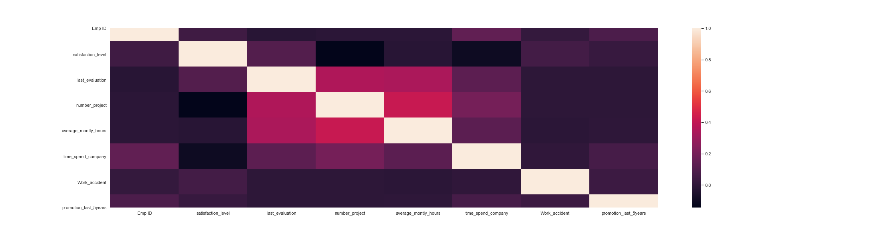
CORRELATION HEATMAP TO UNDERSTAND THE CORRELATION MATRIX

Slide 8
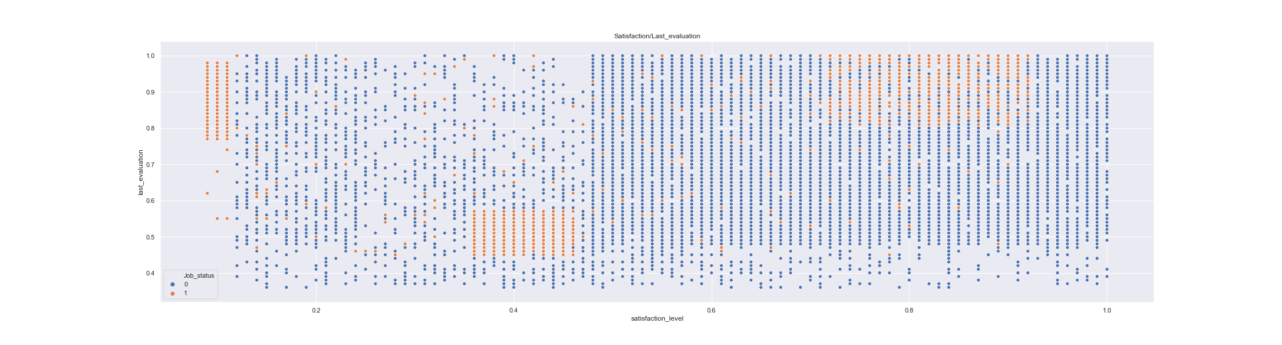
SATISFACTION LEVEL AND LAST EVALUATION PLOT

Slide 9
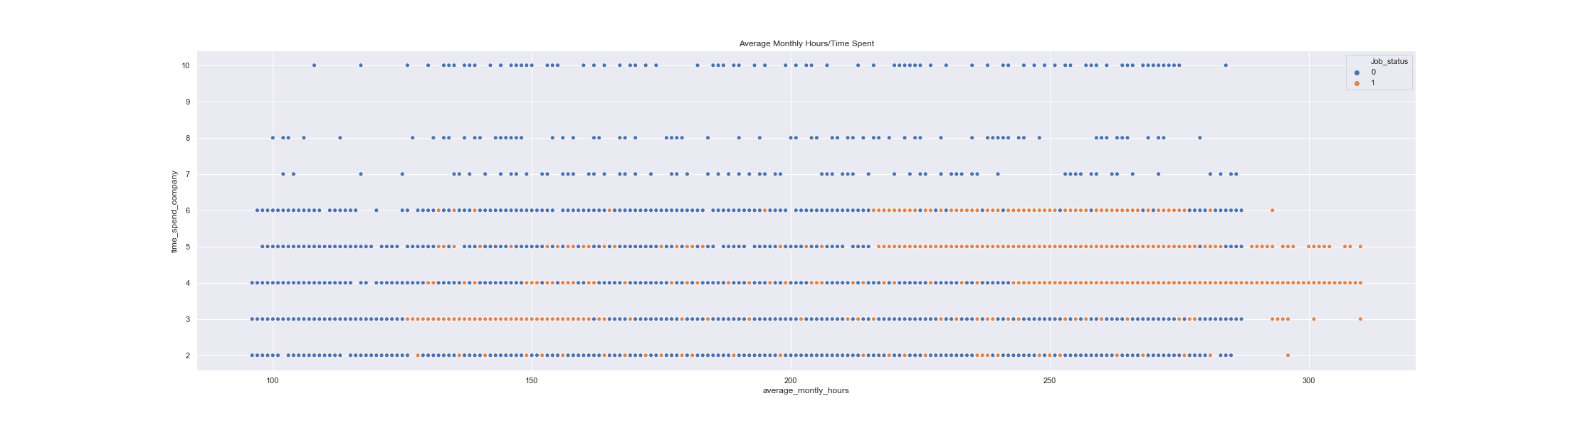
AVERAGE MONTHLY HOURS AND TIME SPENT PLOT

Slide 10
DEDUCTIONS FROM VISUALIZATIONS
Group 1 : low evaluation score, low satisfaction level, low hours worked. based on their hours worked, would probably consists mostly of unmotivated workers or part-time workers. May be subjected to other variables.
Group 2 : high evaluation score, high satisfaction level, high hours worked. Due to their high contribution, they are likely to leave the company to pursue a better opportunity presented (such as poaching/headhunting by other company).
Group 3 : very high evaluation score, very low satisfaction level, very high hours worked. Likely to leave the company due to being overworked

Slide 11
FINDING TRENDS AND CORRELATIONS
This is one of the most important steps in solving the problem at hand. Here, I study the data and visualizations in order to notice trends in specific data columns, correlations between the data of both current and ex employees and identify factors the most likely led to employees leaving the company and checking to see if those factors are present with current employees. This being done by analysing the visualizations like the ones in the previous slides.

Slide 12
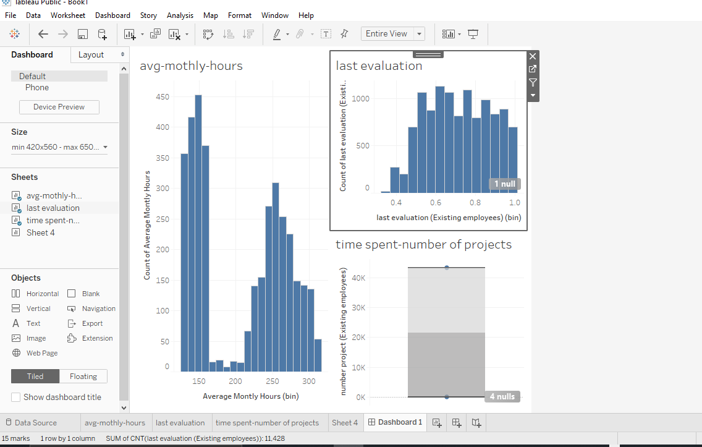
Tableau Visualization

Slide 13
DEDUCTIONS FROM DATA ANALYSIS
Slight positive correlation between number of projects and average monthly hours worked
Employees that left the company tend to have low satisfaction levels
Some employees have low evaluation score, low satisfaction level, low hours worked. based on their hours worked, would probably consists mostly of unmotivated workers or part-time workers. May be subjected to other variables.
Others have high evaluation score, high satisfaction level, high hours worked. Due to their high contribution, they are likely to leave the company to pursue a better opportunity.
And the rest have very high evaluation score, very low satisfaction level, very high hours worked. They are likely to leave the company due to being overworked.

Slide 14
CONCLUSIONS DRAWN
some employees left the company with no specific traits or factors that influenced them to leave
some employees left the company in search for better positions in other companies since they didn't seem to have any underlying factors for leaving
some employees left the company because they are being overworked
Officials should make sure not to give employees more that 6 projects per month
Officials should look out for employees with satisfaction scores of below 0.5. Personal engagement is advised for such employees
Officials should make sure not to work employees for more than 250 hours averagely per month as this may cause employees to leave the company as a result of being overworked.

